Slide 1








TRIVIA
GAME
FOLLOW US!
@notrockettrivia
Not Rocket Science Trivia
Not Rocket Science Trivia
FREE TO PLAY
GIFT CARD PRIZES
@not.rocket.science
www.notrocketsciencetrivia.com

Slide 2

What popular two-word cable TV channel, owned by Discovery, offers shows such as
“Chopped” and “Iron Chef America?”
ROUND 1
GET YOUR
FEET WET
“Call me Ishmael” is the first
line of which iconic novel?
2 POINTS EACH
Which branch of medicine
focuses on the heart?

Slide 3

ROUND 1
GET YOUR
FEET WET
2 POINTS EACH
Food Network

Slide 4
ROUND 1
GET YOUR
FEET WET
2 POINTS EACH
Moby Dick

Slide 5
ROUND 1
GET YOUR
FEET WET
2 POINTS EACH
Cardiology

Slide 6

Year the Today Show premiered
on NBC – 1980
ROUND 2
OVER
UNDER
The number of kings of England
who have been named George – 5
3 POINTS EACH
Distance from downtown Chicago to downtown Indianapolis (shortest driving distance using google maps) – 200 miles

Slide 7
ROUND 2
OVER
UNDER
3 POINTS EACH
Under (1952)

Slide 8
ROUND 2
OVER
UNDER
3 POINTS EACH
Over (6)

Slide 9
ROUND 2
OVER
UNDER
3 POINTS EACH
Under (185)

Slide 10

1
Ukraine shares land borders with two countries that start with the letter R:
Russia and what other nation?
2
3
ROUND 3
TRIFECTA
TRIVIA
What legendary golfer bid a tearful farewell to fans after playing his last U.S. Open in 1994?
3 POINTS EACH
Name every US president who has resigned from office. It is your job to figure out how many presidents have resigned and give their name.

Slide 11
1
2
3
ROUND 3
TRIFECTA
TRIVIA
3 POINTS EACH
Romania

Slide 12
1
2
3
ROUND 3
TRIFECTA
TRIVIA
3 POINTS EACH
Arnold Palmer

Slide 13
1
2
3
ROUND 3
TRIFECTA
TRIVIA
3 POINTS EACH
Richard Nixon

Slide 14

Match the name of the band with their debut album.
ROUND 4
THE LIST ROUND
Bands
Pink Floyd
One Direction
Guns N Roses
Spice Girls
Fall Out Boy
Debut Albums
Up All Night
Take This to Your Grave
Spice
Appetite for Destruction
The Piper at the Gates of Dawn
1 POINT EACH

Slide 15
Pink Floyd – The Piper at the Gates of Dawn
One Direction – Up All Night
Guns N Roses – Appetite for Destruction
Spice Girls – Spice
Fall Out Boy – Take This to Your Grave
ROUND 4
THE LIST ROUND
1 POINT EACH

Slide 16

HALFTIME
BONUS POINTS?
FREE CLUES?
SCAN ME!
JOIN OUR EMAIL LIST TO
RECEIVE BONUS POINTS, PLUS
FREE CLUES FOR THE NEXT GAME!
SCAN THE QR CODE NOW!

Slide 17

GAME SHOW:
Whose Line
is it Anyway?
ROUND 5
GAME SHOW STYLE
4 POINTS EACH

Slide 18
What athlete said in 2010 that his team would win “not two, not three, not four, not
five, not six, not seven” championships?
ROUND 5
GAME SHOW STYLE
What famous Englishman said “All the world’s a stage, and all the men and women merely players”?
4 POINTS EACH
What famous author said “You have brains in your head. You have feet in your shoes. You can steer yourself any direction you choose”?

Slide 19
ROUND 5
GAME SHOW STYLE
4 POINTS EACH
Lebron James

Slide 20
ROUND 5
GAME SHOW STYLE
4 POINTS EACH
William Shakespeare

Slide 21
ROUND 5
GAME SHOW STYLE
4 POINTS EACH
Dr. Seuss
(Theodor Seuss Geisel)

Slide 22

The 1942 movie “The Pride of the
Yankees” is a biopic about whom?
ROUND 6
ENTERTAINMENT
TRIVIA
Finish this Disney movie song lyric
“hi ho, hi ho, it’s off to ____ we go.”
4 POINTS EACH
Name the song and the artist

Slide 23
ROUND 6
ENTERTAINMENT
TRIVIA
4 POINTS EACH
Lou Gehrig

Slide 24
ROUND 6
ENTERTAINMENT
TRIVIA
4 POINTS EACH
Work

Slide 25
ROUND 6
ENTERTAINMENT
TRIVIA
4 POINTS EACH
Answer

Slide 26

ROUND 7
MIXING
THINGS UP
SPECIAL ROUND:
Back to School
5 POINTS EACH

Slide 27
At this university, if students happen to step on the block ‘M,’ legend dictates they must run naked across campus. It’s unknown if famous alumni like Tom Brady, Larry Page and Gerald Ford participated in this tradition.
ROUND 7
MIXING
THINGS UP
Students at this fictional school are prone to break into song and dance, especially amongst groups like the T-Birds and the
Pink Ladies.
5 POINTS EACH
Located about 60 miles outside of London, this renowned university is known as the oldest university in the English-speaking world.

Slide 28
ROUND 7
MIXING
THINGS UP
5 POINTS EACH
University of Michigan

Slide 29
ROUND 7
MIXING
THINGS UP
5 POINTS EACH
Rydell High School (from Grease)

Slide 30
ROUND 7
MIXING
THINGS UP
5 POINTS EACH
University of Oxford

Slide 31

Komodo Island is the famous home of the largest lizard on Earth, the Komodo Dragon.
Komodo is located within what Southeast Asia country of which Jakarta is the capital?
ROUND 8
GAME
CHANGER ROUND
What word, which is also the name of a popular exercise brand, refers to the main group of riders in a cycle race?
6 POINTS EACH
Albert Einstein founded the Emergency Committee of Atomic Scientists in which decade?

Slide 32
ROUND 8
GAME
CHANGER ROUND
6 POINTSEACH
6 POINTS EACH
Indonesia

Slide 33
ROUND 8
GAME
CHANGER ROUND
6 POINTS EACH
Peloton

Slide 34
ROUND 8
GAME
CHANGER ROUND
6 POINTS EACH
1940s (1946)

Slide 35
FINAL TRIVIA
TOPIC:
Geography
IMPORTANT REMINDER:
PLEASE BRING YOUR WAGERS
TO THE HOST

Slide 36

FINAL
TRIVIA
Which of these is the furthest east?
Haiti, Puerto Rico, Dominican Republic,
or the US Virgin Islands?
0 - ALL POINTS

Slide 37
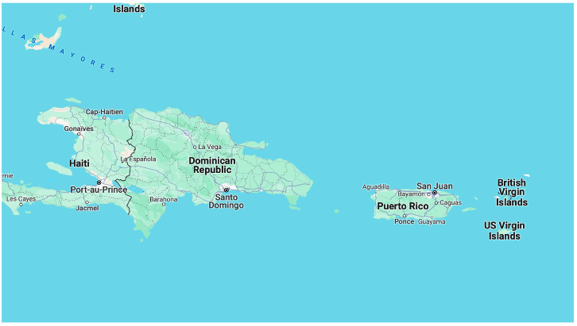
FINAL
TRIVIA
US Virgin Islands
0 - ALL POINTS

Slide 38

FOLLOW US!
@notrockettrivia
Not Rocket Science Trivia
Not Rocket Science Trivia
@not.rocket.science
www.notrocketsciencetrivia.com

